Slide 1

Education system based on AR and game development
Graduation project

Slide 2
Contents of presentation
Introduction | Special thanks and introduce the teamwork.
Problem overview | Simple discussion about the problem.
Idea | How we solved this problem.
Goals | What we want to achieve in this project.
Used Technologies | The programs, tools, packages and programming language we used.
System analysis | Requirements and diagrams in the project.
UI & Implementation | The interface of the application with the implementation of each component.
Conclusion & Futurework | Conclusion, related app and future work.

Slide 3

Special Thanks
No one can deny the great effort from our supervisors ASSOC.Prof/ Lobna Abu-Elmagd ENG/ Esraa Asem.
Thank you for your unforgettable help <3

Slide 4
Teamwork (That Five ☺)
01
Omar Mohammed Sobhy
02
Abdulrahman Hagag El-Fallah
03
Ahmed El-Hossiny Shindy
04
Ali Mohammed Saafan
05
Zakaria Rafeeq Mohamed

Slide 5

Problem Overview
According to psychology researches it’s more efficient to learn in interactive ways like seeing a pictures, watching videos, use animations in teaching and playing some games related to the subject that deliver a particular idea.

Slide 6

Idea
According to that theory , we developed an easy game to teach kids the English alphabetic by listening and repeat the letters of some words while watching animated models of the word using AR and game development.

Slide 7
Brushstrokes of a Gadfly.
“Well, if it can be thought, it can be done, a problem can be overcome.”

Slide 8
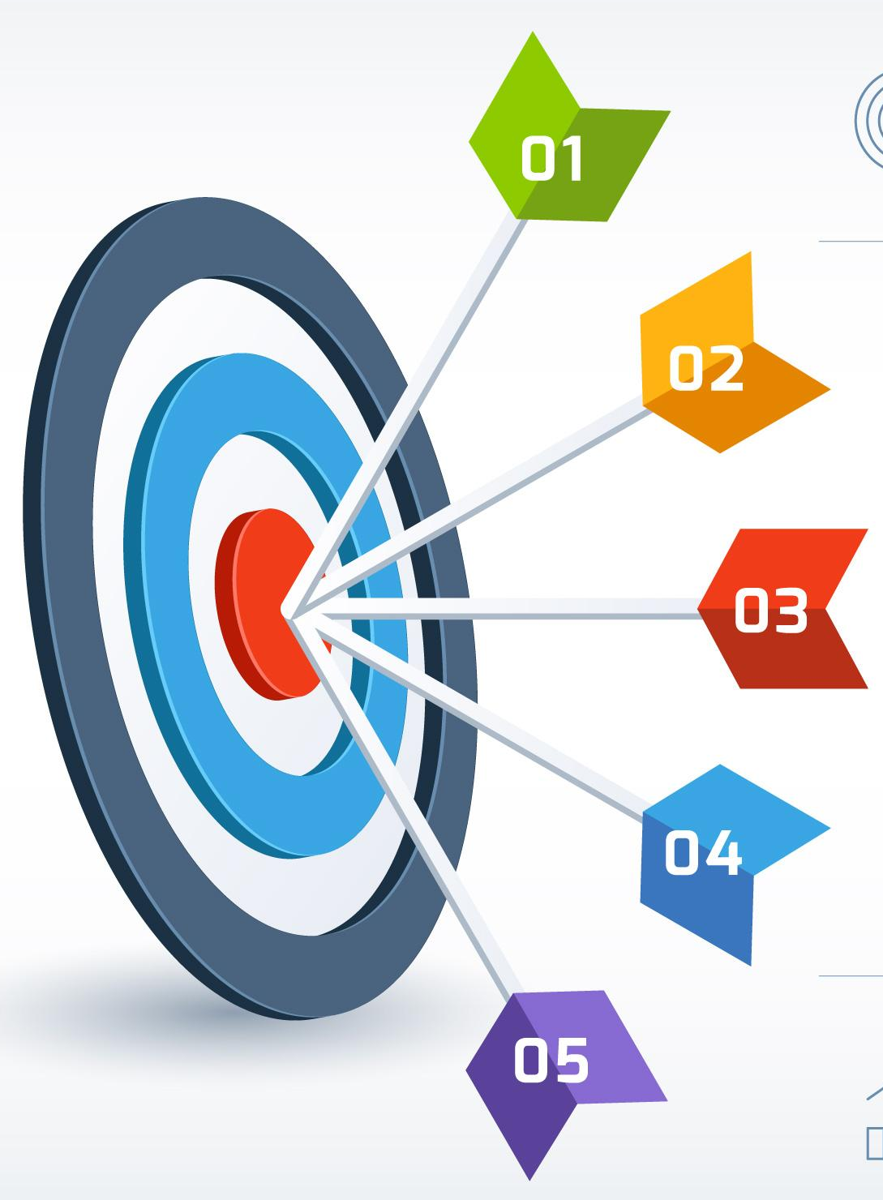
Goals
Create an interactive and miniature educational game to make it easier and more fun for kids to learn English.
Enhancing the learning process by applying scientific and educational theories.
Get over the problem of lack of attention in the educational process
Providing an enjoyable and easy learning experience for children.
Use development to create modern learning methods that ease the concept of learning

Slide 9

Technology Used.
Unity & C#.
Augmented Realty (create interactive game).
Unity ARFoundation package (create augmented reality plane and surface detection).
Text Mesh Pro (text rendering solution).
Blender (creating , editing and animating 3d models).
Photoshop (designing user interfaces and visual assets).
Wit.ai (convert text to speech with a human voice).
Speechly (detect the user speech accurately, speech to text).

Slide 10


Technology Used
Unity Engine
C#
Unity is a cross-platform game engine and development tool that is widely used for creating 2D and 3D games, as well as simulations, virtual reality and augmented reality applications.
C# is widely used for game development, particularly with the Unity game engine. Unity provides a scripting API that allows developers to write C# scripts to control the behaviour of game objects. C# scripts can be attached to game objects in Unity.

Slide 11
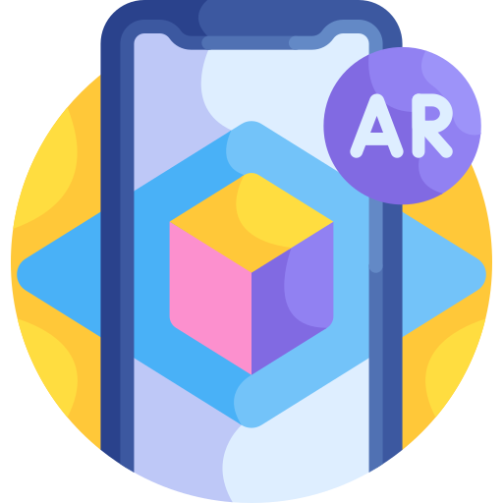



Technology Used
Augmented Reality
Text Mesh Pro
Unity ARFoundation package
Blender
AR is a technology that overlays digital information, such as images, graphics, or sound, onto the real world in real-time.
is a Unity plugin that allows developers to create high quality, customizable text in their projects
Blender is a free and open-source 3D creation software that allows developers to create models, animations, and visual effects
it provides a set of tools and APIs for creating AR experiences that can be deployed on both Android and iOS devices

Slide 12



Technology Used
Photoshop
Wit.ai
Speechly
Photoshop is a popular image editing software developed by Adobe Systems, it provides a wide range of tools and features for editing and manipulating images, including support for layers, filters, and effects.
Wit.ai is a natural language processing (NLP) platform that allows developers to create chatbots and voice assistants
Speechly is a speech recognition platform that allows developers to create natural language voice interfaces for their applications

Slide 13



System analysis
Determining Requirements
Functional Requirements
Non-Functional Requirements

Slide 14
System analysis
Functional requirements are the features and functions that the system must perform to meet user needs
Augmented reality
User progress
The system should provide an augmented reality environment for the user
The system should have different levels for the user to progress through
Functional requirements
STT
TTS
The system should detect user voice to check the user spelling
The system should have text to speech feature

Slide 15
System analysis
Non-functional requirements are the system's qualities, such as performance, usability, and security.
Response
Navigation
The system should have fast response times to user input.
The system should be easy to use and navigate for the user
Non-functional requirements
Errors rate
Android validation
The system should have a low rate of errors and bugs
The system should be compatible with multiple android devices

Slide 16
Diagrams
Use Case
Sequence
Context
1
3
2
4
Class

Slide 17
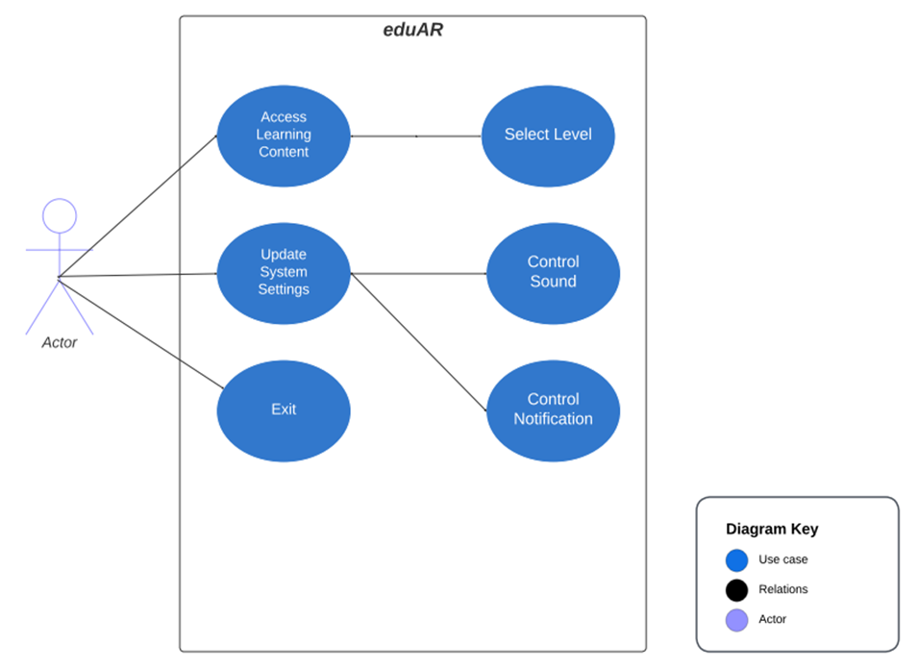
Use Case Diagram

Slide 18
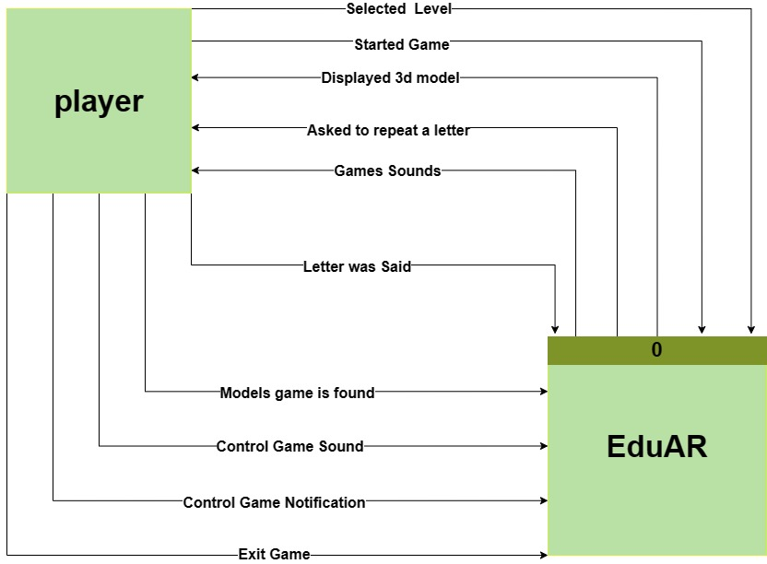
Context Diagram

Slide 19
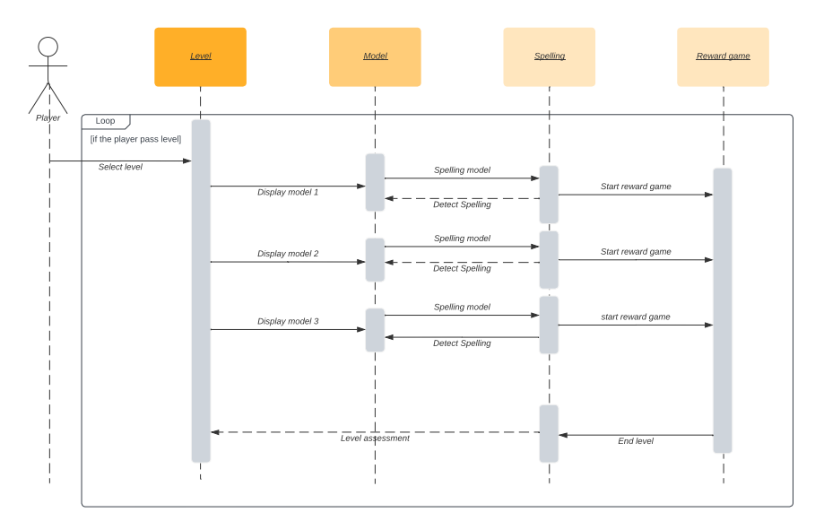
Sequence Diagram

Slide 20
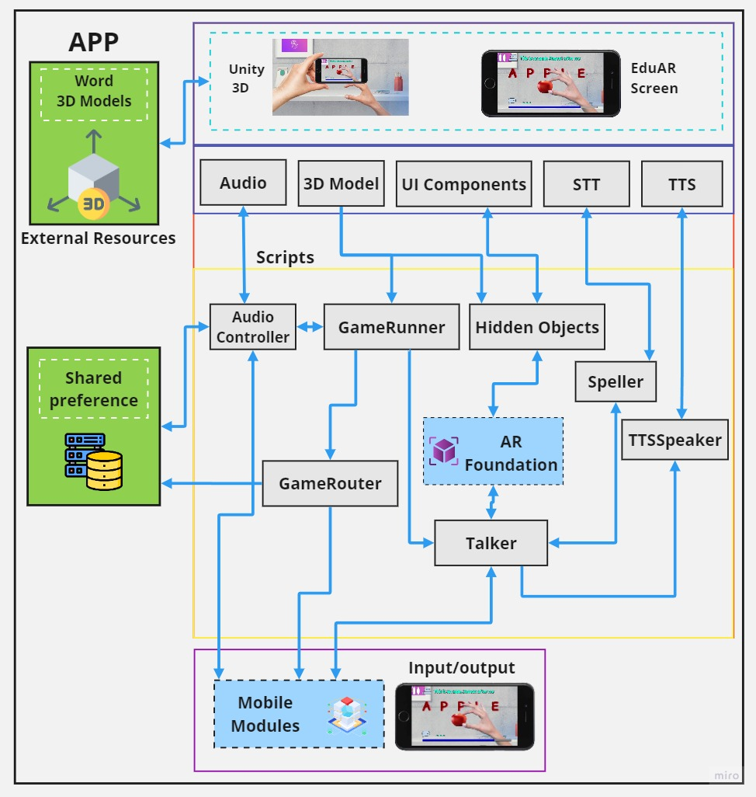
UI & Implementation
illustration of the system component

Slide 21
UI & Implementation
Main Screen

Slide 22
UI & Implementation
Settings Screen

Slide 23
UI & Implementation
Select Level Screen

Slide 24
UI & Implementation
Level Screen (Game Screen)

Slide 25
UI & Implementation
Level Screen (Menu Screen)

Slide 26
UI & Implementation
Level Screen (Check Connection Screen)

Slide 27
UI & Implementation
Reward game Screen

Slide 28

Future work

Slide 29
Future work
Inclusive Education
Augmented Reality Content Creation
Use augmented reality to make education more accessible and inclusive for students with disabilities.
Develop tools that enable educators to create their own augmented reality content.
Collaborative Learning
Develop features that enable students to collaborate and learn together in an augmented reality environment
Multilingual Education
Develop an augmented reality system that can provide educational content in multiple languages.

Slide 30

Future work
Visual book

Slide 31
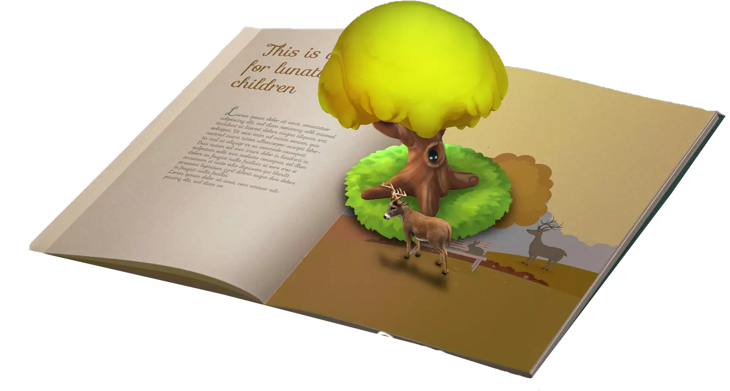
Future work
One of the promising ideas we intend to pursue involves creating augmented reality-enhanced Visual books. By integrating AR technology with traditional print media, we can bridge the gap between static text and dynamic, immersive learning experiences. Imagine a visual book filled with illustrations that, when viewed through a smartphone or tablet camera, come to life as three-dimensional objects, complete with detailed educational information and interactive elements.

Slide 32
Conclusion
In conclusion, the future of EduAR is bright and full of potential. As we continue to push the boundaries of augmented reality and explore new avenues for interactive learning, we remain steadfast in our commitment to transform education for the better. With each innovative idea and every new development, we take another step towards making education more engaging, enjoyable, and effective for all.

